Slide 1







Enterprise Blockchain Developers (Intermediate)
In support of
Powered By

Slide 2
Outline
What is POS?
POS Mechanism
POW VS POS
Ethereum 2.0
© 2017-2020 SmartMesh Foundation Pte. Ltd. | MeshBox Foundation Pte. Ltd.

Slide 3
What is POS?
Proof-of-stake (PoS) is a consensus algorithm for blockchain networks that is based on randomly selected validators, who “stake” the native network’s tokens by locking them into the blockchain, to produce and approve blocks. Validators are rewarded based on their total stake, incentivizing nodes to validate the network based on a return on investment (ROI).
How to randomly selected?
1 Staking age
2 Randomization
3 Node's Wealth

Slide 4


POS Mechanism
Step 1: Staking
Step 2: Ramdon Selection: Radomized Block Selection and Coin Age Selection

Slide 5
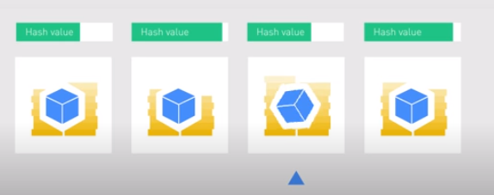
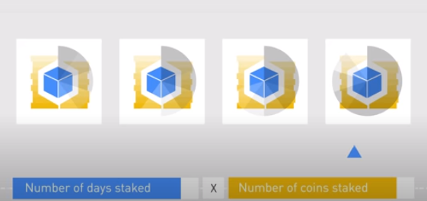
POS Mechanism
Randomized Block Selection: Lowest Hash Value and Hightest Stake (this could be predicted)
Coin Age Selection: days staked X coins numbers, when selected, age goes to zero

Slide 6
POS Mechanism
Therefore, every POS consensus mechanism could customize the the weight of this combination

Slide 7
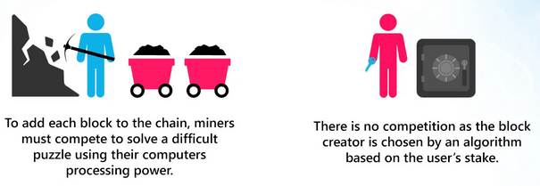

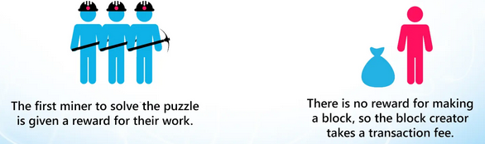
POW VS POS

Slide 8
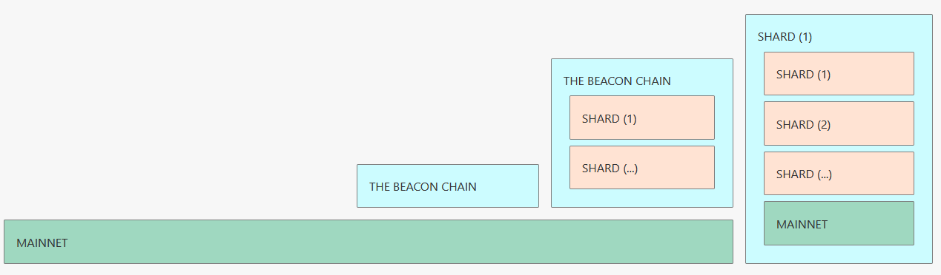
Ethereum 2.0
Phase 0: Beacon Chain: Staking
Phase 1: Sharding
Phase 2: Docking
https://launchpad.ethereum.org/checklist
https://launchpad.ethereum.org/

